Slide 1
Operation bletchley
Critical Bomb disposal mission 1945

Slide 2
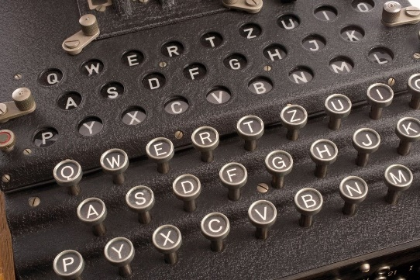
Operation Bletchley - bomb alert!
It is 1945. Nazi Germany is on the verge of defeat after being invaded by the Russian forces from the East, and Allied forces from the West.
You are a group of top-secret codebreakers at Bletchley Park, England. Thanks to you the Enigma codes of the Nazi high command were broken.
However, your celebrations have been cut short when you receive an anonymous phone call that a bomb has been planted in your operations room by an enemy spy. The caller is a double agent who was pretending to help this spy with their evil work. She is keen to help you escape but had to hide clues in the room so as not to blow her own cover. The bomb is in a suitcase in the center of the room. Your job is to crack the code of the lock so you can open the case and defuse the bomb. You have 40 minutes after 5 minutes exploration.

Slide 3
Your task
You need to locate TEN missions. It is up to you to decide how to divide these between the members of your team.
Each time you locate a mission, alert your teacher.
Each time you complete a mission, give the answer to your teacher.
Your teacher will then ‘stop the clock’ to read out the mission, the answer (maybe with elaboration), and then a timeline event slip which will be given to the class on paper.
When ALL of the missions are completed, you should assemble the timeline pieces together in the correct order.
This will help you crack the code and defuse the bomb!
Good luck!

